Slide 1
Bioinformatics
Faster, better, stronger

Slide 2
De stof komt uit de college presentaties en Jonathan Pevsner "Bioinformatics and Functional Genomics"
(Wiley Blackwell; 3e editie) en een aantal extra papers
(deze worden niet expliciet in de betrokken colleges genoemd, en zijn te vinden onder "achtergrond").
Lecture | Topic | Chapter | Pages | Comments
1 | Bioinformatics | 1 | Helemaal
2 | Access to seq data | 2 | Helemaal | Niet "Command line access"
3 | Sequence Alignment | 3 | 70-103 | Niet box 3.5, box 3.7, box 3.8
4 | BLAST | 4 | 121-134, 138-143, 145-159 | Niet fig.4.14, box 4.1, p.143 E- en p-values
5 | Database searching | 5 | 171-177 | Niet box 5.1
6 | Next Generation Sequencing | 9 | 377-384

Slide 3
Presentation content
Chapter 9: pg. 377 - 384

Slide 4
Chapter 9:
Analysis of next-generation sequence data
Jonathan Pevsner, Ph.D.
pevsner@kennedykrieger.org
Bioinformatics and Functional Genomics
(Wiley-Liss, 3rd edition, 2015)
You may use this PowerPoint for teaching purposes

Slide 5
Human genome sequencing
We currently obtain whole genome sequences at 30x to 50x depth of coverage. For a typical individual:
2.8 billion base pairs are sequenced
~3-4 million single nucleotide variants
~600,000 insertions/deletions (indels)
Cost (research basis) is <$2000 per genome
We try to sequence mother/father/child trios

Slide 6
Human genome sequencing
We currently obtain whole genome sequences at 30x to 50x depth of coverage. For a typical individual:
2.8 billion base pairs are sequenced
~3-4 million single nucleotide variants
~600,000 insertions/deletions (SNPs)
Cost (research basis) is <$2000
We try to sequence mother/father/child trios
We also can enrich the collection of exons (“whole exome sequencing”). For a typical individual:
60 million base pairs are sequenced
There are ~80,000 variants
There are ~11,000 nonsynonymous SNPs

Slide 7
Sanger sequencing: what we had before NGS
Introduced in 1977
A template is denatured to form single strands, and extended with a polymerase in the presence of dideoxynucleotides (ddNTPs) that cause chain termination.
Typical read lengths are up to 800 base pairs. For the sequencing of Craig Venter’s genome (2007; first whole genome of an individual), Sanger sequencing was employed because of its relatively long read lengths.

Slide 8
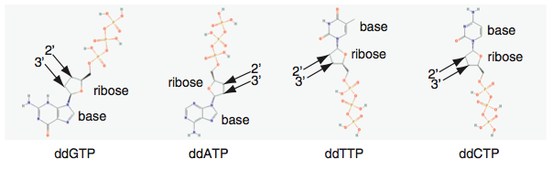
DNA sequencing by the Sanger method
Dideoxynucleotides (ddNTPs)( -OH of dNTP is replaced by -H of ddNTP at the 2’ ribose position)
B&FG 3e
Fig.9-1
Page 380

Slide 9
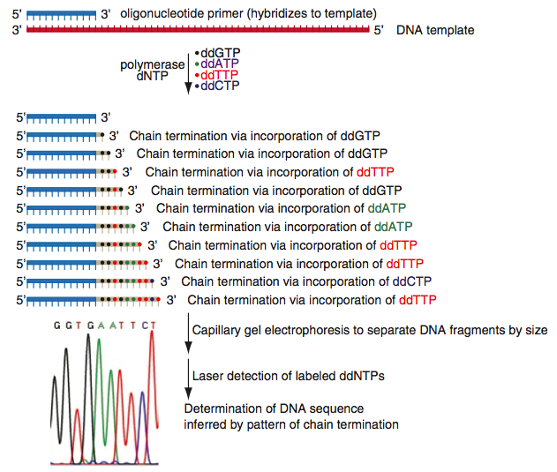
DNA sequencing by the Sanger method
Primer elongation, chain termination upon incorporation of ddNTP, separation, detection
B&FG 3e
Fig.9-1
Page 380

Slide 10
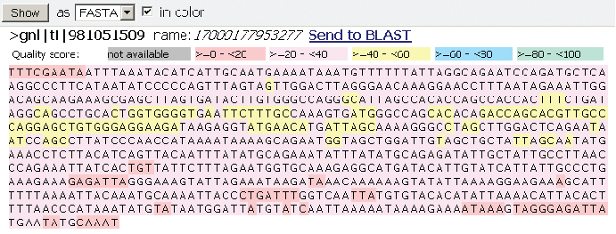
View genomic DNA (here from the beta globin locus) from the Trace Archive at NCBI: FASTA format
B&FG 3e
Fig.9-2
Page 381

Slide 11
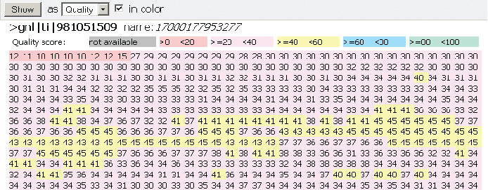
Each DNA base in the Trace Archive has an associated base quality score
(best scores highlighted in yellow)
B&FG 3e
Fig.9-2
Page 381

Slide 12
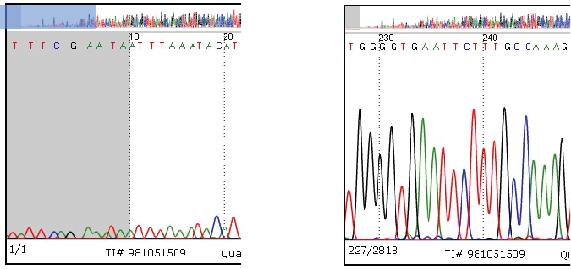
Examples of Sanger sequencing traces
Low quality reads
High quality reads
B&FG 3e
Fig.9-2
Page 381

Slide 13
Next-generation sequence technologies
Technology | Read length (bp) | Reads per run | Time per run | Cost per megabase | Accuracy
Roche 454 | 700 | 1 million | 1 day | $10 | 99.9%
Illumina | 50-250 | <3 billion | 1-10 days | ~$0.10 | 98%
SOLiD | 50 | ~1.4 billion | 7-14 days | $0.13 | 99.9%
Ion Torrent | 200 | <5 million | 2 hours | $1 | 98%
Pacific Biosciences | 2900 | <75,000 | <2 hours | $2 | 99%
Sanger | 400-900 | N/A | <3 hours | $2400 | 99.9%
Source: adapted from Wikipedia 1/11/13

Slide 14
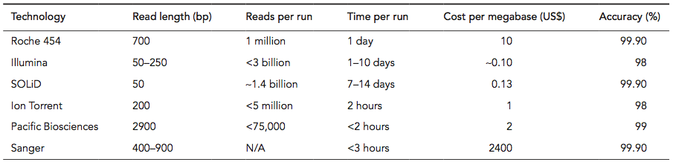
NGS technologies compared to Sanger sequencing
B&FG 3e
Table 9-1
Page 382

Slide 15
Whole genome sequencing (WGS) costs
have declined dramatically
B&FG 3e
Fig.9-3
Page 383

Slide 16
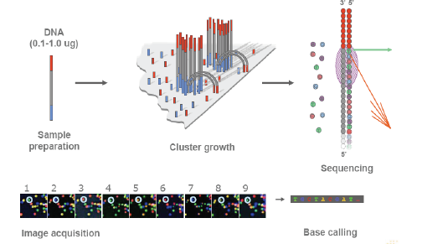
Next-generation sequence technology: Illumina

Slide 17
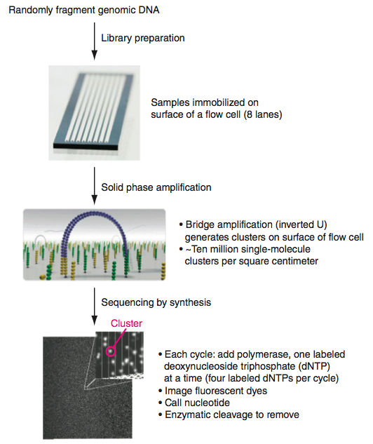
Sequencing by Illumina technology
B&FG 3e
Fig.9-4
Page 384

Slide 18
Cycle termination sequencing (Illumina)
Disadvantage:
Short read length (~150 bases)
Advantages:
Very fast
Low cost per base
Large throughput; up to 1 gigabase/epxeriment
Short read length makes it appropriate for resequencing
No need for gel electrophoresis
High accuracy
All four bases are present at each cycle, with sequential addition of dNTPs. This allows homopolymers to be accurately read.

Slide 19
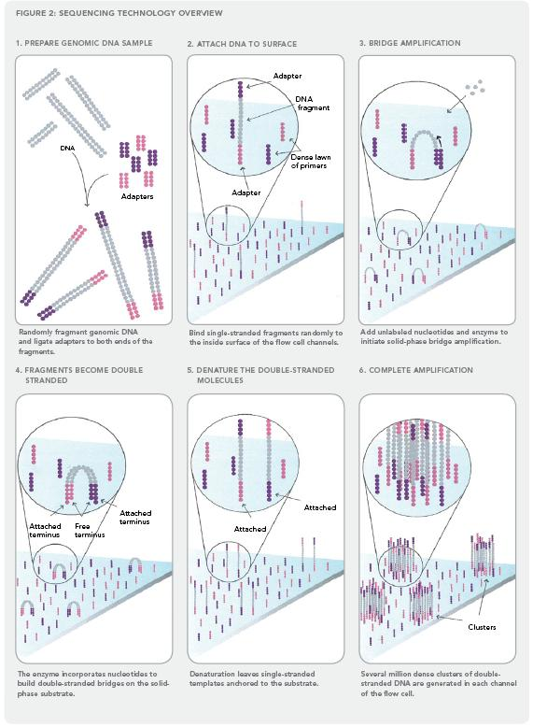
Illumina sequencing technology in 12 steps
Source: http://www.illumina.com/downloads/SS_DNAsequencing.pdf
Notes:
19

Slide 20
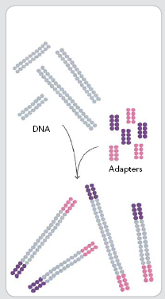
1. Prepare genomic DNA
2. Attach DNA to surface
3. Bridge amplification
4. Fragments become double stranded
5. Denature the double- stranded molecules
6. Complete amplification
DNA
adapters
Randomly fragment genomic DNA and ligate adapters to both ends of the fragments

Slide 21

adapter
DNA fragment
1. Prepare genomic DNA
2. Attach DNA to surface
3. Bridge amplification
4. Fragments become double stranded
5. Denature the double- stranded molecules
6. Complete amplification
dense lawn of primers
adapter
Bind single-stranded fragments randomly to the inside surface of the flow cell channels

Slide 22
1. Prepare genomic DNA
2. Attach DNA to surface
3. Bridge amplification
4. Fragments become double stranded
5. Denature the double- stranded molecules
6. Complete amplification
Add unlabeled nucleotides and enzyme to initiate solid-phase bridge amplification

Slide 23
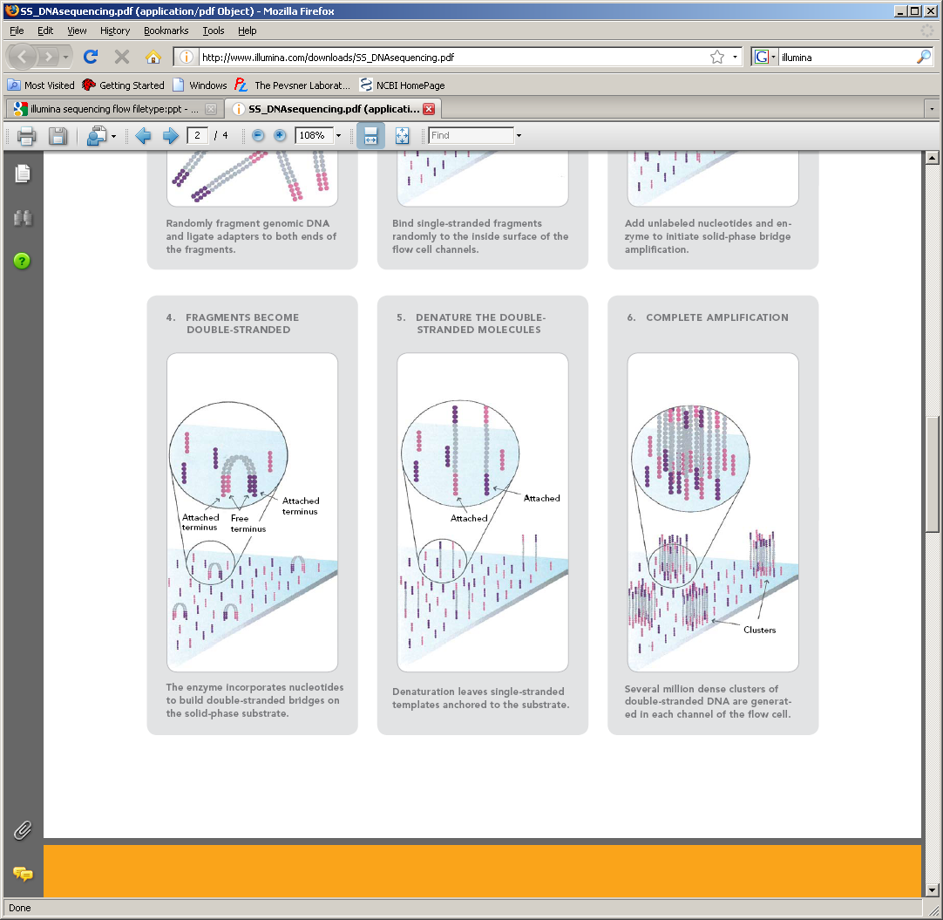
1. Prepare genomic DNA
2. Attach DNA to surface
3. Bridge amplification
4. Fragments become double stranded
5. Denature the double- stranded molecules
6. Complete amplification
Attached
terminus
Attached terminus
free
terminus
The enzyme incorporates nucleotides to build double-stranded bridges on the solid-phase substrate

Slide 24
1. Prepare genomic DNA
2. Attach DNA to surface
3. Bridge amplification
4. Fragments become double stranded
5. Denature the double- stranded molecules
6. Complete amplification
Attached
Attached
Denaturation leaves single-stranded templates anchored to the substrate

Slide 25
1. Prepare genomic DNA
2. Attach DNA to surface
3. Bridge amplification
4. Fragments become double stranded
5. Denature the double- stranded molecules
6. Complete amplification
Clusters
Several million dense clusters of double-stranded DNA are generated in each channel of the flow cell

Slide 26
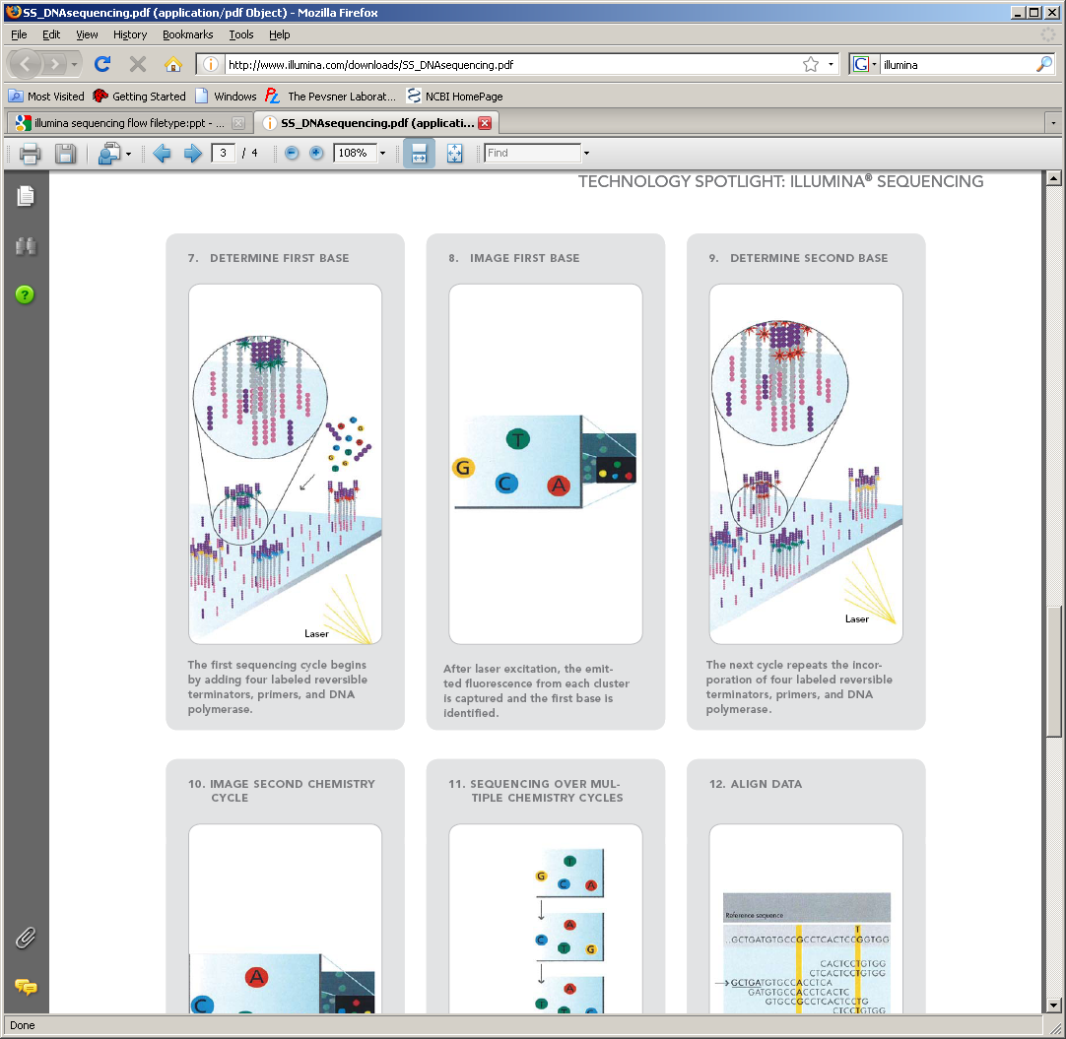
7. Determine first base
8. Image first base
9. Determine second base
10. Image second chemistry cycle
11. Sequencing over multiple chemistry cycles
12. Align data
Laser
The first sequencing cycle begins by adding four labeled reversible terminators, primers, and DNA polymerase

Slide 27
7. Determine first base
8. Image first base
9. Determine second base
10. Image second chemistry cycle
11. Sequencing over multiple chemistry cycles
12. Align data
After laser excitation, the emitted fluorescence from each cluster is captured and the first base is identified

Slide 28
7. Determine first base
8. Image first base
9. Determine second base
10. Image second chemistry cycle
11. Sequencing over multiple chemistry cycles
12. Align data
Laser
The next cycle repeats the incorporation of four labeled reversible terminators, primers, and DNA polymerase

Slide 29
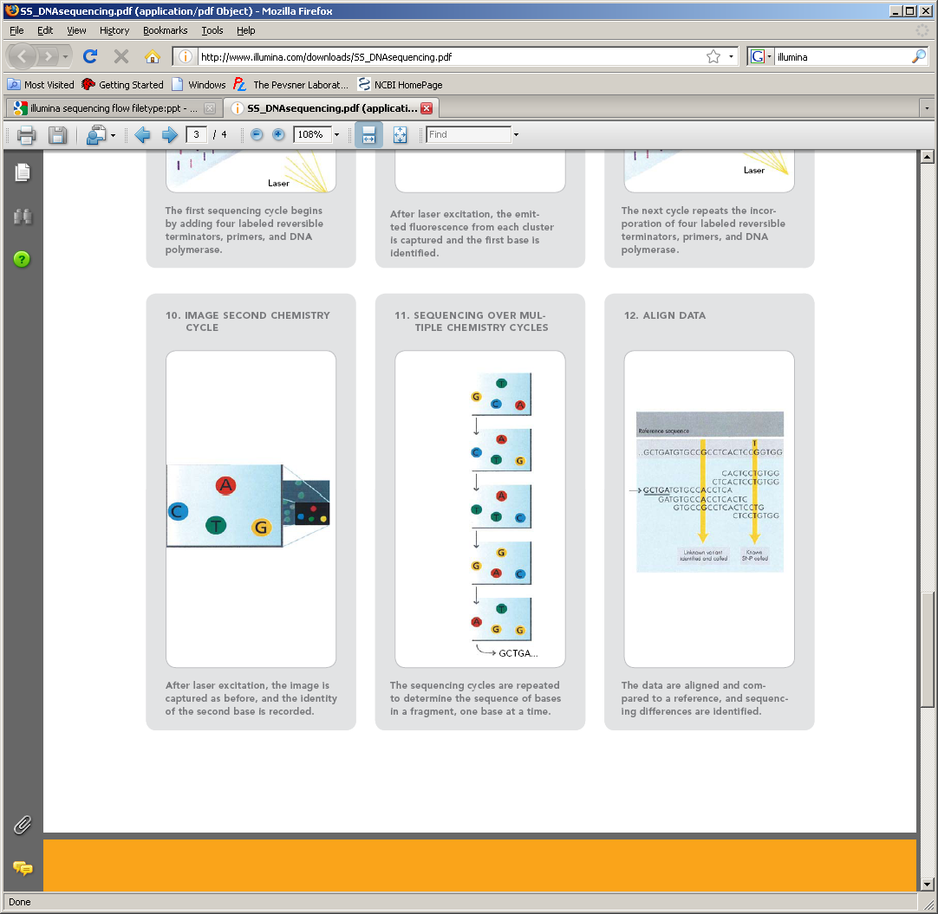
7. Determine first base
8. Image first base
9. Determine second base
10. Image second chemistry cycle
11. Sequencing over multiple chemistry cycles
12. Align data
After laser excitation the image is captured as before, and the identity of the second base is recorded.

Slide 30
7. Determine first base
8. Image first base
9. Determine second base
10. Image second chemistry cycle
11. Sequencing over multiple chemistry cycles
12. Align data
The sequencing cycles are repeated to determine the sequence of bases in a fragment, one base at a time.

Slide 31
Reference sequence
7. Determine first base
8. Image first base
9. Determine second base
10. Image second chemistry cycle
11. Sequencing over multiple chemistry cycles
12. Align data
Unknown variant identified and called
Known SNP called
The data are aligned and compared to a reference, and sequencing differences are identified.

Slide 32
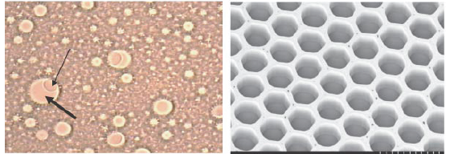
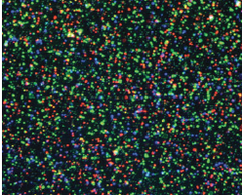
NGS technologies: Roche 454
Introduced in 2005 (sequenced Mycoplasma genitalium genome in one run)
~2400 publications (as of Jan. 2013) but now defunct
Sequencing by synthesis: nucleotide incorporation leads to light emission
Notes:
32

Slide 33
Pyrosequencing
Advantages:
Very fast
Low cost per base
Large throughput; up to 40 megabases/epxeriment
No need for bacterial cloning (with its associated artifacts); this is especially helpful in metagenomics
High accuracy
Disadvantages:
Short read lengths (soon to be extended to ~500 bp)
Difficulty sequencing homopolymers accurately

Slide 34
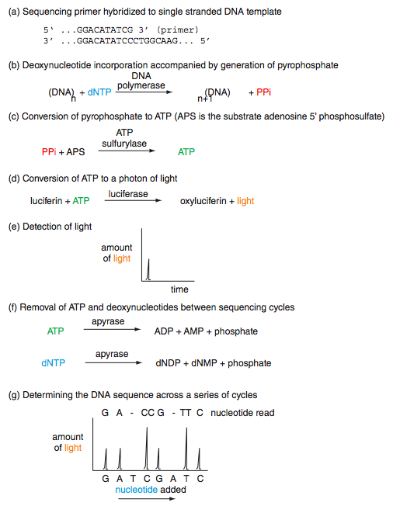
Pyrosequencing
B&FG 3e
Fig.9-5
Page 386

